Slide 1





Prediction analysis on loan approval using Data Mining Techniques
Group Members:
Pradeep Kamble :10511829
Nikhil Gharge : 10517429
Nishant Mathur :10508561

Slide 2
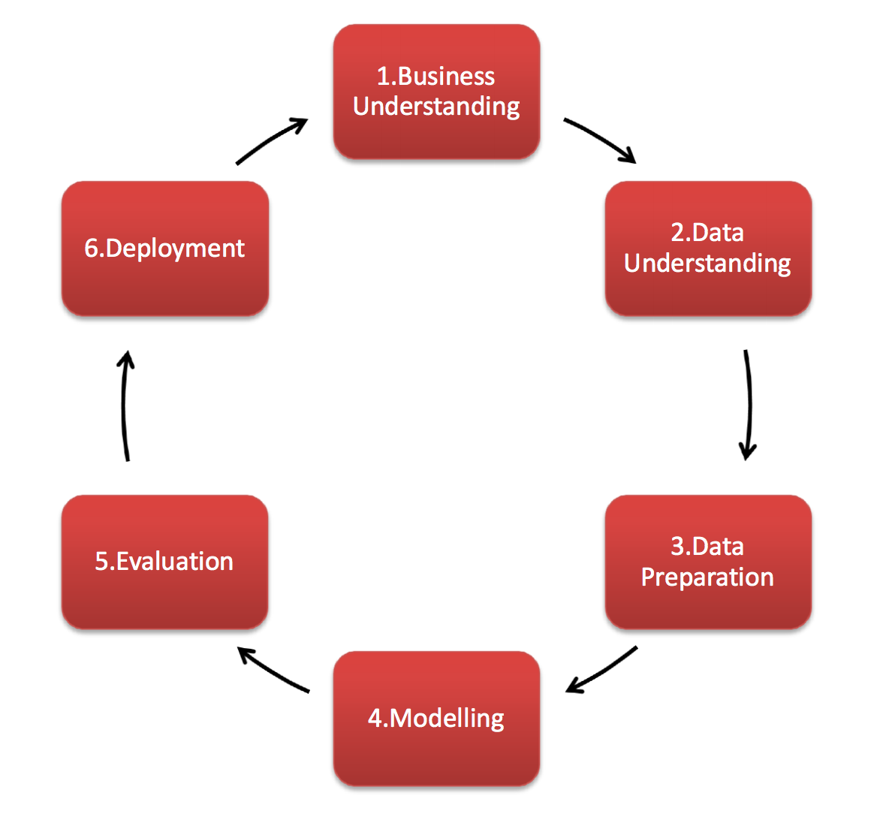
Layout:
Introduction
CRISP-DM Process
Business Understanding
Data Understanding
Data Preparation
Modelling
Evaluation
Deployment
Conclusion

Slide 3
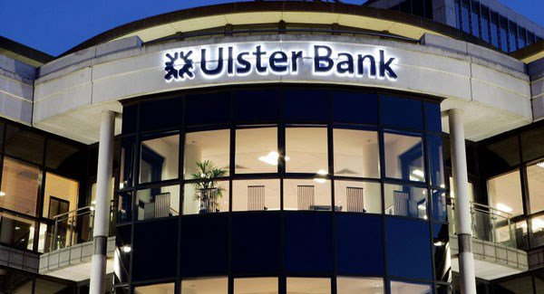
Introduction:
Bank plays a vital role in market economy.
The success or failure of organization largely depends on the industry’s ability to evaluate credit risk.
In today’s world, taking loans from financial institutions has become a very common phenomenon.
Everyday a large number of people make application for loans, for a variety of purposes. But all these applicants are not reliable and everyone cannot be approved.
Every year, we read about a number of cases where people do not repay bulk of the loan amount to the banks due to which they suffers huge losses.
So, our main task is to gather loan data from multiple data sources and use data mining technique CRISP-DM on this data to extract important information and predict if a customer would be able to repay his loan or not.
In other words predict if the customer would be a defaulter or not.
Basically the loan defaulter prediction is a binary classification problem; so we are using two tools Rapid Miner Studio and Python.

Slide 4
CRISP-DM Process:
CRISP-DM, is a Model which stands for Cross-Industry Standard Process for Data Mining (Eckerson et al., 2000), and it gives Structured approach for planning data mining project.
These Model is not privately owned and controlled by any organization and most important it is freely available data mining model.
As a Methodology, it provides process framework for designing, creating, building, testing and deploying machine learning solutions (Stirrup, 2017).
The idea of these model was invented by four leaders Daimler-Benz, Integral Solutions Ltd. (ISL), NCR, and OHRA in late 1996.
These Model have mainly six phases which are as follows: I)Business understanding ii) Data understanding iii) Data preparation iv) Modeling v) Evaluation vi) Deployment.

Slide 5
Business Understanding:
Distribution of the loan is a main business objective of commercial and cooperative banks.
The ultimate goal of this data mining project is to extract the patterns and information from common approval datasets.
We build the model in order to predict the likely loan defaulters using data mining techniques.
So, we use three models namely as Generalized linear model, logistic regression and Random forest and compare their results.
Our main focus on historical data of the customer such as gender, material status, no of dependents, education, income and loan amount.

Slide 6
Data Understanding:
We take dataset from Kaggle website.
The link is as follows:
https://www.kaggle.com/sajidvali/loan-prediction
The dataset contain Loan ID which gives information regarding to loan status.
The remaining key elements are Gender, Marital status, Number of dependents, Education qualification, Income of Applicant and Co-applicant along with loan amount and property area of that person.

Slide 7
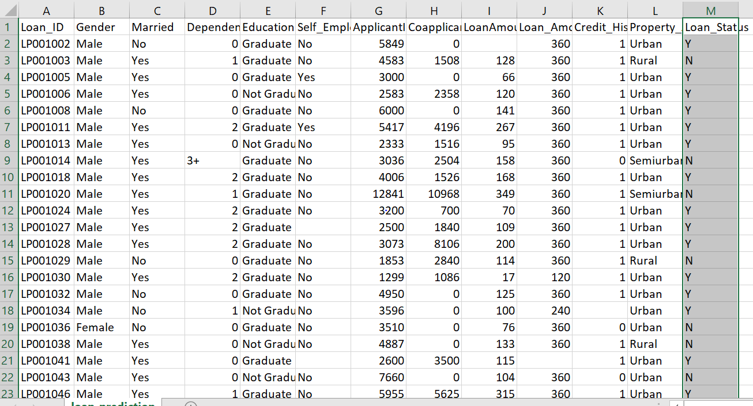
Actual Dataset: Target Variable (Loan Status)

Slide 8
Data Preparation:
Dataset Contain 151 missing values in different columns of the dataset.
These missing values is filled by taking mean values in numerical data and other values is filled by using keyword missing.
The overall implementation was done in Rapid miner tool in that we are using Turbo prep which automatically Clean the data.
In this process, we remove Loan id column which have no significance and not affecting the prediction results.

Slide 9
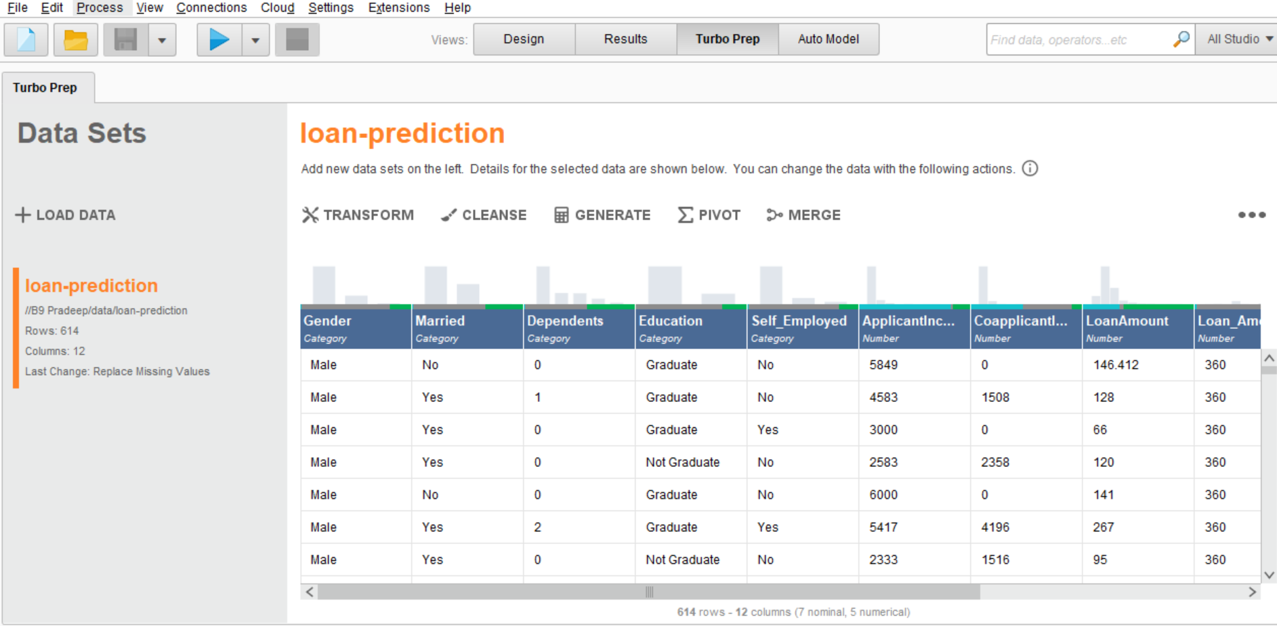

Slide 10
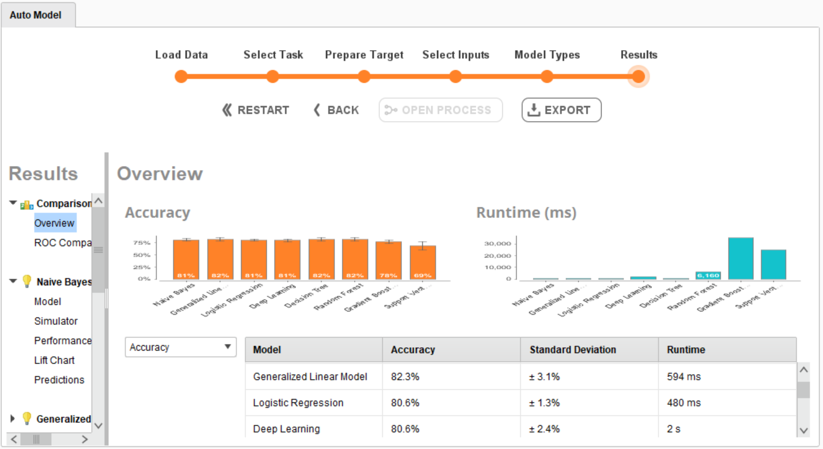
Modelling:
In modelling phase, we are using different machine learning algorithms to predict the defaulters and non-defaulters.
So, firstly we check which algorithm gives us more accuracy, for that we put our csv (dataset) file into Auto model.
The results are shown in screenshot.

Slide 11
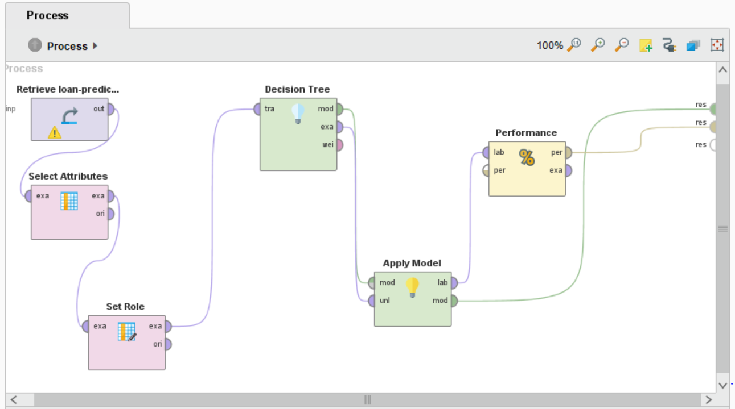
1) Decision Trees:

Slide 12
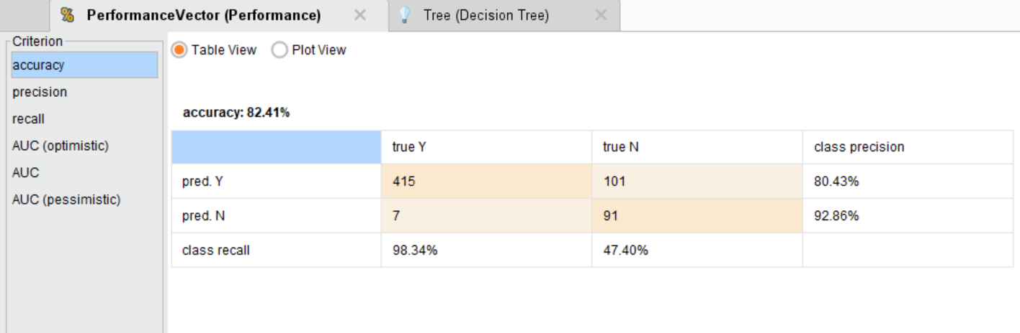
Results: Accuracy is 82.41%

Slide 13
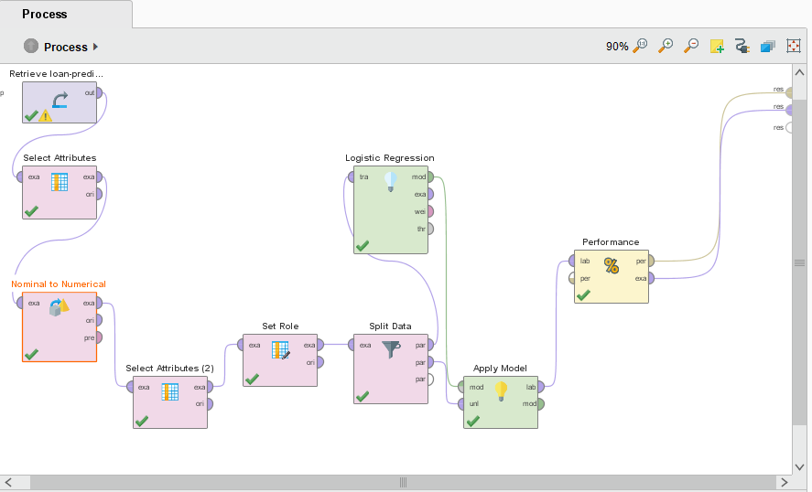
2)Logistic Regression:

Slide 14
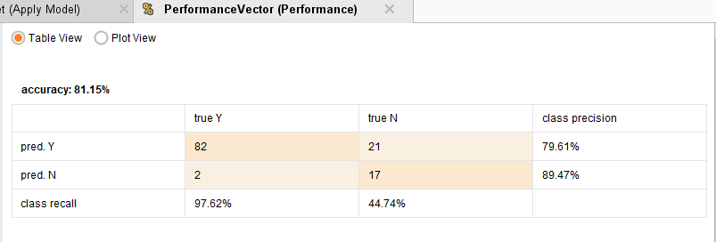
Results: Accuracy is 81.15%

Slide 15

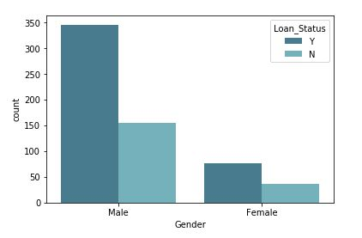
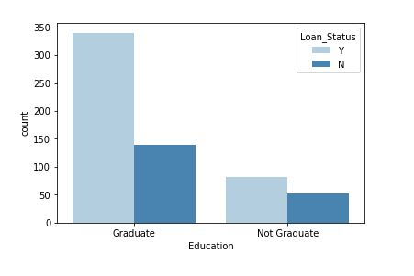
Evaluation:
The evaluation stage evaluate and analyse the model to check whether it fulfilled the business objectives or not.
In some cases, it gives the justification when the model is deficient.
So, we evaluate four graphs in our project.

Slide 16
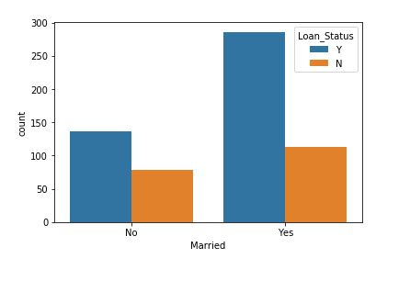
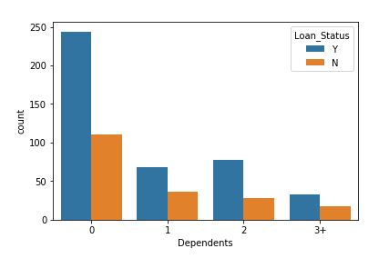
In married bar graph, if the person is married then he has more number of chances to get a loan and vice versa.
In Dependents bar graph, we can easily determine that the more number of dependents the less number of chances to get loan.

Slide 17
Deployment:
Deployment is the process of using new features to make development in current organization.
It also generates reports and performs data mining process for maintenance.
This phase has mainly four phases such as planning of deployment, monitoring and maintenance, production of the final report by project leader and last phase is the whole review of the project which gives us errors and mistakes and using the appropriate data mining technique.
The knowledge gained from this project will be organized and implement in Shiny app so that customer can use it.
This involves applying live model as a general framework where bank can use any previous data (can select data of choice) within organization’s decision making processes.

Slide 18
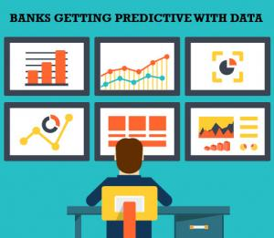
Future Work:
Time series analysis can be done using loan data of several years for prediction of the approximate time when the client can default.
An application can be built, which will predict whether their loan application can be approved by banks based on their inputs along with approximate interest rates.

Slide 19
References:
[1] Yun, Z., Weihua, L., Yang, C., 2014. Applying balanced scordcard strategic performance management to CRISP-DM, in: 2014 International Conference on Information Science, Electronics and Electrical Engineering. Presented at the 2014 International Conference on Information Science, Electronics and Electrical Engineering (ISEEE), IEEE, Sapporo, Japan, pp. 2009–2014. https://doi.org/10.1109/InfoSEEE.2014.6946275
[2] Azevedo, A., Santos, M.F., 2008. KDD, SEMMA AND CRISP-DM: A PARALLEL OVERVIEW 5.
[3] Stirrup, J., 2017. What’s wrong with CRISP-DM, and is there an alternative? Jen Stirrup. https://jenstirrup.com/2017/07/01/whats-wrong-with-crisp-dm-and-is-there-an- alternative/ (accessed 6.24.19).
[4] Eckerson, W.W., Hanlon, N., Barquin, R., 2000. DIRECTOR OF EDUCATION AND RESEARCH 5, 15.

Slide 20
Thank You Any Questions???

